Slide 1
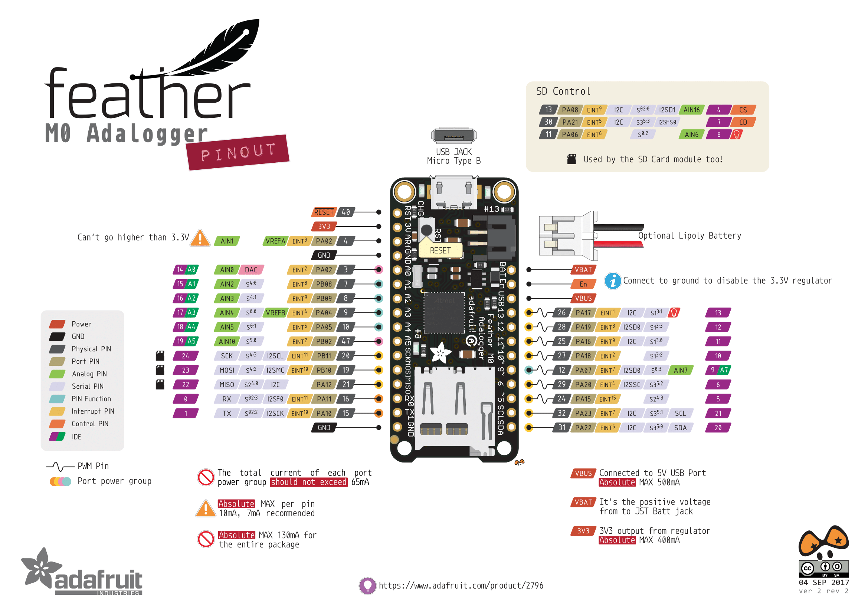
SD_CS (internal)
SD_CD (internal)
SD_LED (internal)
IR_2
VBAT (ext)
SW
EN
LED_RED (internal)
PW_SERVO
SERVO
PW_RFID
IR_SEND
TEMP
IR_1
TEMP
LED
TEMP
TEMP_CS
RFID_TX
PW_3V
RFID_RX
RTC
RTC

